Slide 1
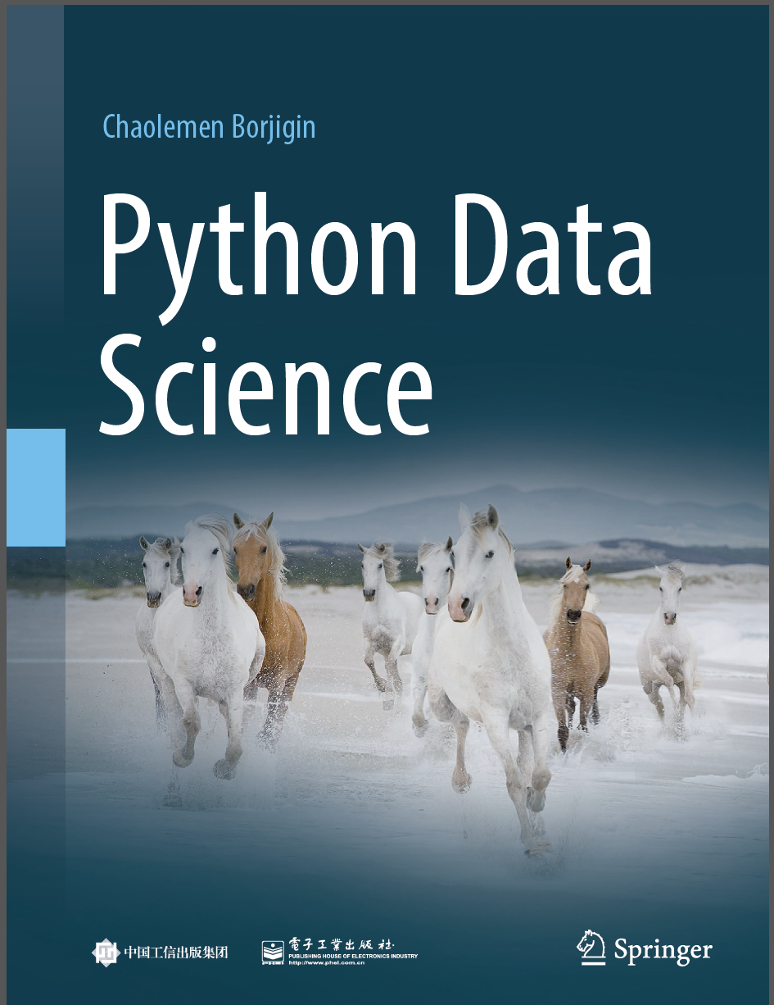
Python Data Science
Chaolemen Borjigin
  Renmin University of China
  chaolemen@ruc.edu.cn

Slide 2
2.18 Module functions
▼ Chapter 2 Basic Python Programming for Data Science
► 2.18 Module functions
Chaolemen Borjigin
  Renmin University of China
  chaolemen@ruc.edu.cn

Slide 3
Summary of this chapter
▼ Chapter 2 Basic Python Programming for Data Science
► 2.18 Module functions
2.18.1 import module name
2.18.3 from module name import function name
2.18.2 import module name as alias

Slide 4
2.18.1 import module name
▼Chapter 2 Basic Python Programming for Data Science
► 2.18 Module functions
In[2]:
import math
math.sin(1.5)
Out[2]:
0.9974949866040544

Slide 5
2.18.1 import module name
▼Chapter 2 Basic Python Programming for Data Science
► 2.18 Module functions
In[3]:
cos(1.5)
---------------------------------------------------------------------------
NameError Traceback (most recent call last)
<ipython-input-3-edeaf624fe76> in <module>
----> 1 cos(1.5)
NameError: name 'cos' is not defined

Slide 6
2.18.1 import module name
▼Chapter 2 Basic Python Programming for Data Science
► 2.18 Module functions
In[4]:
math.cos(1.5)
Out[4]:
0.0707372016677029

Slide 7
2.18.2 import module name as alias
▼Chapter 2 Basic Python Programming for Data Science
► 2.18 Module functions
In[5]:
import math as mt
mt.sin(1.5)
Out[5]:
0.9974949866040544

Slide 8
2.18.3 from module name import function name
▼Chapter 2 Basic Python Programming for Data Science
► 2.18 Module functions
In[6]:
from math import cos
cos(1.5)
Out[6]:
0.0707372016677029
In[7]:
from math import sin
sin(1.5)
Out[7]:
0.9974949866040544

Slide 9


